Slide 1
Instructions to the presenter
Start MAMP before presentation so that we can show some live demos

Slide 3
Phil Mason
Phil has used SAS every day for 34 years. He has written 3 SAS books, many courses and lots of papers and presentations for User Groups around the world. He’s an Aussie and Brit who lives in the UK near Oxford.

Slide 4
How to Use JavaScript Libraries Easily with SAS® Stored Processes
Wood Street Consultants

Slide 5
Why use a web browser as a User Interface
Enables building almost anything
HTML defines the content of page
Wide range of tags available table, form, iFrame, h1…h9, div, span, canvas, lists, etc.
CSS describes the style of HTML
Color, font-size, borders, icons, tables, links, etc.
JavaScript makes things happen
Gets data, animates, inserts/changes HTML/CSS, generate browser specific content, validate input, populate fields, implement advanced UI components, etc.

Slide 6

Advantages of libraries
“Stand on the shoulders of Giants”
Why code everything from scratch?
Collections of code are out there
CSS libraries
like Bootstrap 4 & FontAwesome
JavaScript libraries
Some providing a whole framework, some just a few features

Slide 7



Some JavaScript libraries
UI Frameworks – Angular, React, backbone.js
Utility libraries – jQuery, underscore, moment, MathJS, h54s
Graph libraries – D3, dyGraphs, DC.js, CrossFilter, Muze.js, ChartJS
Table libraries – handsonTable, dataTables, pivotTable
Framework = Application Skeleton

Slide 8




Considerations before you do web development
Get a good editor
Notepad++, Microsoft Visual Studio Code, IDEA, Atom, Brackets
Choose your web browser carefully
Do you have to support all browsers or a particular one?
Check the web developer tools & available add-ons
Checkout other useful tools
Lint tools, package managers, documentation generators
https://www.jslint.com

Slide 9
Getting from SAS to the web browser
Stored Process Web Application
Runs a SAS Stored Process on SAS Server from a URL
Files and parameters can be sent to server for processing by SAS
Returns output to web browser (the thing that invoked URL)
Output can be different types such as HTML, data, PDF, etc.

Slide 10
Sending things from Stored Process to browser
Used with SAS Stored Process Web Application
Output is written to browser by writing to _webout
ODS output can be written using %stpbegin and %stpend
%stpbegin ;
Proc print data=sashelp.class ;
Run ;
%stpend ;
Data _null_ ;
File _webout ;
Put '<html><body>’ ; Put '<h1>Hello World!</h1>’ ; Put '</body></html>' ;
Run ;

Slide 11
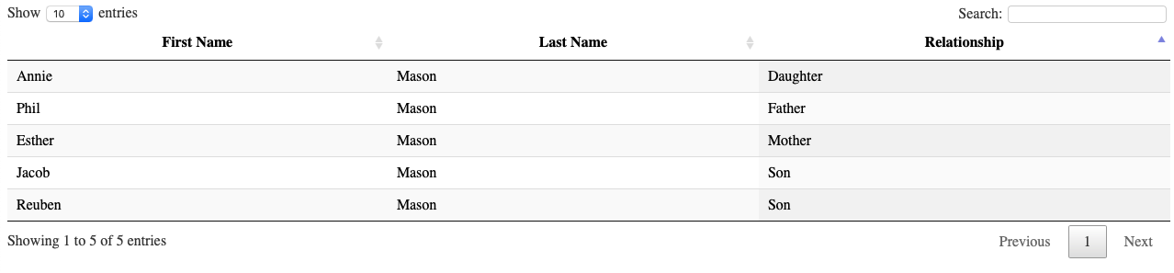
DataTables
https://datatables.net
Features
Pagination, search, multi-column ordering, almost any data source, theme-able, lots of extensions, mobile friendly, internationalisable, incredible documentation, open source and free!
https://datatables.net/examples/index

Slide 12
Basic DataTables example
https://datatables.net
<html>
<head>
<link rel="stylesheet" href="https://cdn.datatables.net/1.10.19/css/jquery.dataTables.min.css" />
<script type="text/javascript" src="https://code.jquery.com/jquery-3.3.1.js"></script>
<script type="text/javascript" src="https://cdn.datatables.net/1.10.19/js/jquery.dataTables.min.js"></script>
<script>
var dataset=[
["Phil","Mason","Father"],
["Esther","Mason","Mother"],
["Jacob","Mason","Son"],
["Annie","Mason","Daughter"],
["Reuben","Mason","Son"]
] ;
$(document).ready(function(){
$("#example").DataTable({
data: dataset,
columns: [
{title: "First Name"},
{title: "Last Name"},
{title: "Relationship"}
]
}) ;
}) ;
</script>
</head>
<body>
<table class="display" id="example">
</table>
</body>
</html>
http://localhost:8888/example1.html
Notes:
I could write this to _webout from data step
Data is included in the code, which is bad

Slide 13
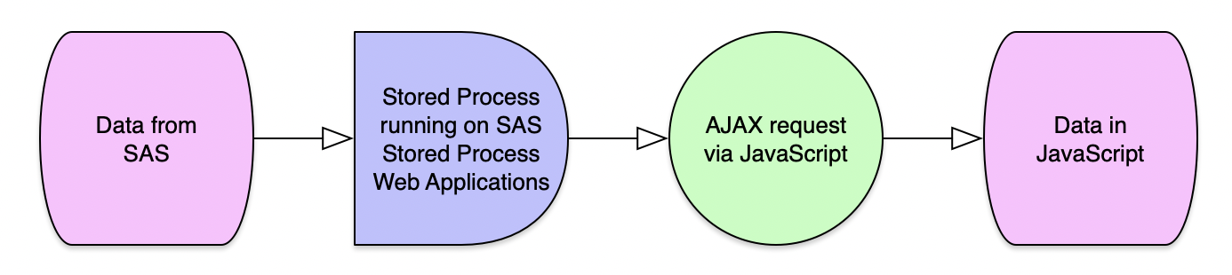
How to get data from a URL
https://datatables.net
in datatables
Use AJAX to point to a URL from which data is read
ajax: ”http://server/path/file.ext”
AJAX requests run asynchronously in the background
url might be a static file
url could be a program that returns data
Notes:
Data can come in from an external file using AJAX

Slide 14
HTML & JavaScript
https://datatables.net
AJAX points to a file
<html>
<head>
<link rel="stylesheet" href="https://cdn.datatables.net/1.10.19/css/jquery.dataTables.min.css" />
<script type="text/javascript" src="https://code.jquery.com/jquery-3.3.1.js"></script>
<script type="text/javascript" src="https://cdn.datatables.net/1.10.19/js/jquery.dataTables.min.js"></script>
<script>
$(document).ready(function(){
$("#example").DataTable({
ajax: "http://d351tq92/example2.json"
}) ;
}) ;
</script>
</head>
<body>
<table class="display" id="example">
<thead>
<tr>
<th>First Name</th>
<th>Last Name</th>
<th>Relationship</th>
</tr>
</thead>
</table>
</body>
</html>
Notes:
AJAX points to file using URL

Slide 15
Switching data to a file
https://datatables.net
example2.json
{
"data": [
["Phil","Mason","Father"],
["Esther","Mason","Mother"],
["Jacob","Mason","Son"],
["Annie","Mason","Daughter"],
["Reuben","Mason","Son"]
]
}
http://localhost:8888/example2.json
Notes:
Now we use file, rather than having data with code
JSON file will be described later

Slide 16
How do we get data from SAS
https://datatables.net
URL points to Stored Process Web Application
_program parameter specifies the stored process to run
$(document).ready(function(){
$("#example").DataTable({
ajax: "http://d351tq92/SASStoredProcess/do?_program=/User+Folders/phil/My+Folder/example2"
}) ;
}) ;
http://localhost:8888/example2.html
Notes:
Stored Process will deliver JSON data

Slide 17
SAS Stored Process code
https://datatables.net
data _null_ ;
file _webout ;
input ;
put _infile_ ;
cards ;
{
"data": [
["Phil","Mason","Father"],
["Esther","Mason","Mother"],
["Jacob","Mason","Son"],
["Annie","Mason","Daughter"],
["Reuben","Mason","Son"]
]
}
;;
run ;
SAS program
Reads text in from cards
Writes JSON to _webout
Stored Process Web App
_webout text is streamed to browser
Notes:
We can use this code to write JSON directly to browser

Slide 18
Easier way to make JSON data in SAS
https://datatables.net
PROC JSON helps you make JSON
Set out= it to _webout so it is sent back to the client that called it – the browser, AJAX invocation, etc.
To get the JSON format needed we write an array with exported table inside it.
[
]
proc json out=_webout nosastags pretty ;
write open array ;
export sashelp.class ;
write close ;
run ;
Notes:
Easier than a data step

Slide 19
JSON data produced
[] signify an array
{} signify an object
Keys are variables
Their values are values of variable
Export statement in PROC JSON produces the objects
This is just first part of JSON produced
[ { "Name": "Alfred", "Sex": "M", "Age": 14, "Height": 69, "Weight": 112.5 }, {"Name": "Alice", "Sex": "F", "Age": 13, "Height": 56.5, "Weight": 84 }, {"Name": "Barbara",

Slide 20
JSON from Stored Process becomes an object
Most important part to understand
$.ajax({
url: "http://d351tq92/SASStoredProcess/do?_program=/User+Folders/phil/My+Folder/example5",
dataType: "json",
success: function (data_from_stp) {
console.log("SUCCESS:");
console.log(data_from_stp);
JavaScript to make table follows on next slide…
JavaScript console shows data loaded from SAS via AJAX
http://localhost:8888/example4.html
Notes:
JSON automatically converted to JavaScript array of objects
See array in Console

Slide 21
JavaScript to use JSON data
From Proc Json via SAS Stored Process
$.ajax({
url: "http://d351tq92/SASStoredProcess/do?_program=/User+Folders/phil/My+Folder/example5",
dataType: "json",
success: function (data_from_stp) {
console.log("SUCCESS:");
console.log(data_from_stp);
$("#example").DataTable({
data: data_from_stp,
columns: [
{data: "Name", title: "Name"},
{data: "Sex", title: "Sex"},
{data: "Age", title: "Age"},
{data: "Height", title: "Height"},
{data: "Weight", title: "Weight"}
] }); },
error: function (data) { console.log("ERROR:");
} });
Notes:
Pass array as data to table
Columns defines what to use from each object in array
Data is variable/key, title is column title

Slide 22
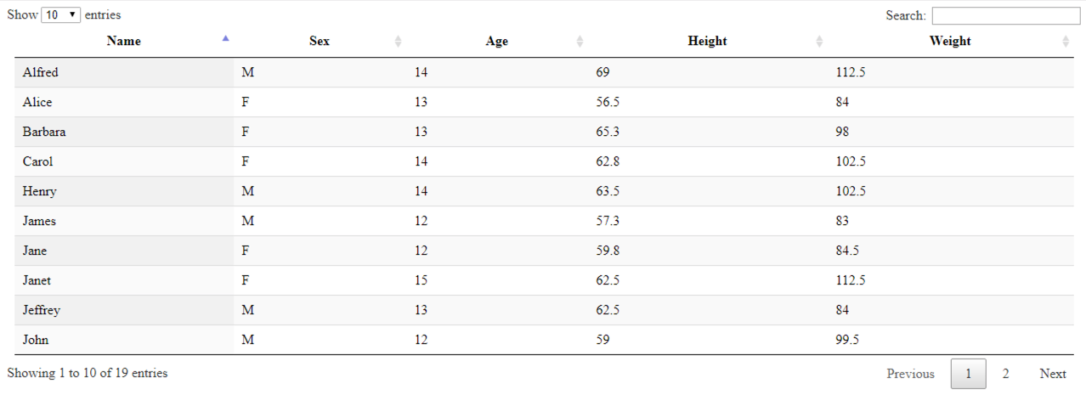
Table produced
Notes:
That’s dataTables, next pivot tables

Slide 23
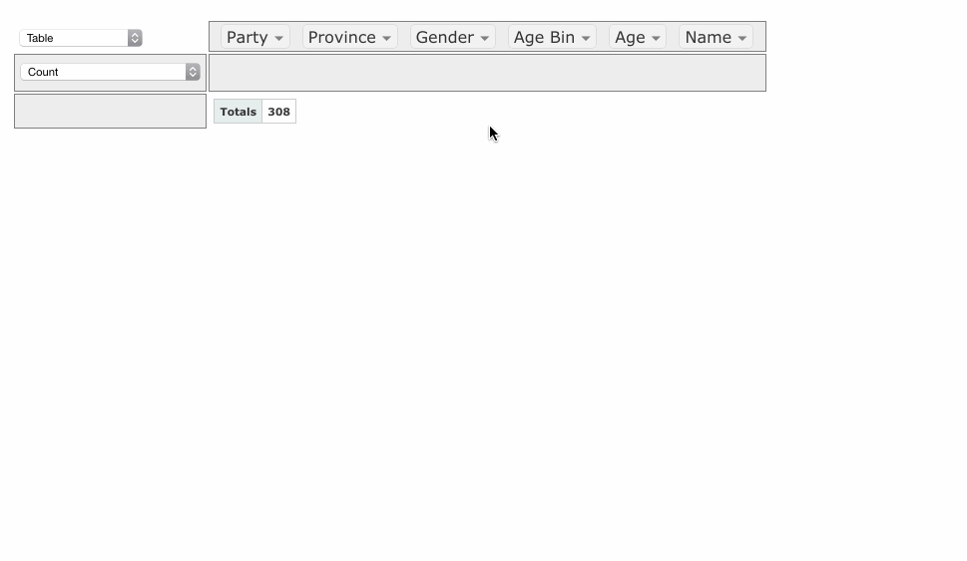
PivotTable.js
https://pivottable.js.org/examples/
Create EXCEL-like Pivot Tables in the browser
Notes:
Let animation play

Slide 24
HTML code
https://pivottable.js.org/examples/
Point to the libraries
<link rel="stylesheet" href="https://cdnjs.cloudflare.com/ajax/libs/pivottable/2.23.0/pivot.min.css" />
<script type="text/javascript” src="https://code.jquery.com/jquery-3.3.1.js"></script>
<script type="text/javascript” src="https://cdnjs.cloudflare.com/ajax/libs /pivottable/2.23.0/pivot.min.js"></script>
<script type="text/javascript” src="https://cdnjs.cloudflare.com/ajax/ libs/jqueryui/1.11.4/jquery-ui.min.js"></script>

Slide 25
Javascript code
https://pivottable.js.org/examples/
$(document).ready(function(){
$.ajax({ url: "http://d351tq92/SASStoredProcess/do?_program=/User+Folders/phil/My+Folder/example7", dataType: "json", success: function (data_from_stp) { console.log("SUCCESS:"); console.log(data_from_stp); $("#table1").pivotUI(data_from_stp['sashelp.orsales']) ; $("#table2").pivotUI(data_from_stp['sashelp.snacks']) ; }, // success error: function (data) { console.log("ERROR:"); } }); }) ;

Slide 26
HTML code
https://pivottable.js.org/examples/
<h3>sashelp.orsales (912 rows, 200k)</h3>
<div id="table1"></div>
<h3>sashelp.snacks (35,770 rows, 3meg)</h3>
<div id="table2"></div>
Notes:
Simple HTML
Id gives a target for JavaScript to create pivot tables

Slide 27
SAS Code
produces JSON data
proc json out=_webout pretty nosastags ;
write open object ;
write values "sashelp.orsales" ;
write open array ;
export sashelp.orsales ;
write close ;
write values "sashelp.snacks" ;
write open array ;
export sashelp.snacks ;
write close ;
write close ;
run ;
{
sashelp.orsales:
[
object per row
]
sashelp.snacks:
[
object per row
]
}
Notes:
This PROC JSON writes 2 tables out to a single object
Can have any number of tables

Slide 28
JSON produced by stored process
{
"sashelp.orsales": [
{
"Year": 1999,
"Quarter": "1999Q1",
"Product_Line": "Children",
"Product_Category": "Children Sports",
"Product_Group": "A-Team, Kids",
"Quantity": 286,
"Profit": 4980.15,
"Total_Retail_Price": 8990.9
},
{
"Year": 1999,
"Quarter": "1999Q1",
Row 1
http://localhost:8888/example7.json
Notes:
SAS table becomes an array or objects
Each object is a row
Each object/row has key/value pairs where key is the variable

Slide 29
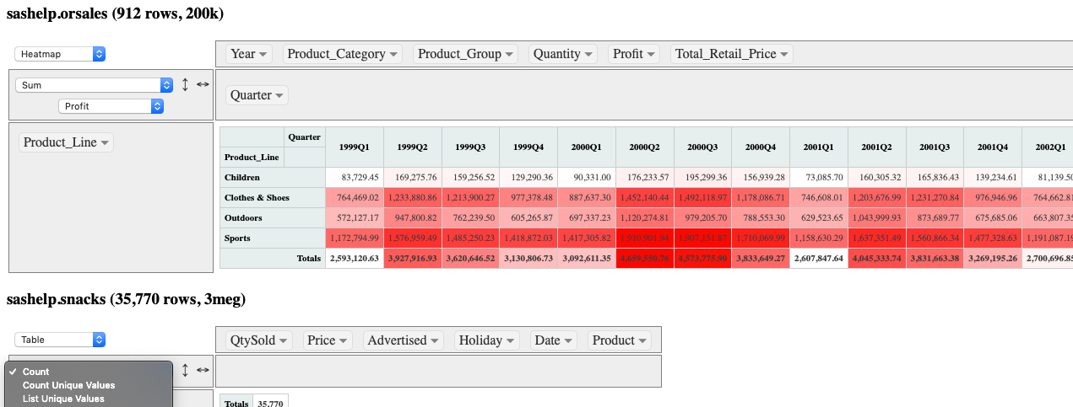
Pivot tables produced
https://pivottable.js.org/examples/
http://localhost:8888/example7.html

Slide 30
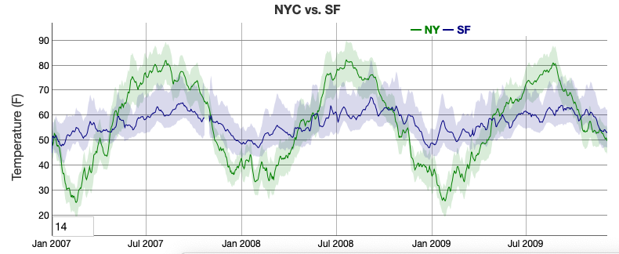
Dygraphs
http://dygraphs.com
Free, fast, flexible, open source charting library
new Dygraph(div, "ny-vs-sf.txt", { legend: 'always’, title: 'NYC vs. SF’, showRoller: true, rollPeriod: 14, customBars: true, ylabel: 'Temperature (F)’ });
Great for Time Series Graphs
http://dygraphs.com
Notes:
Little bit of code can make great graphs

Slide 31
HTML
http://dygraphs.com
<link rel="stylesheet” href="https://cdnjs.cloudflare.com/ajax/libs/dygraph/2.1.0/dygraph.css" />
<script type="text/javascript" src="https://code.jquery.com/jquery-3.3.1.js"></script>
<script type="text/javascript" src="https://cdnjs.cloudflare.com/ajax/libs/dygraph/2.1.0/dygraph.js"></script>
Notes:
Uses a CDN, but you can copy libraries to your own web server
SAS provide a free web server

Slide 32
JavaScript
http://dygraphs.com
$(document).ready(function(){
var g1 = new Dygraph(
document.getElementById("graph"),
"http://d351tq92/SASStoredProcess/do?_program=/User+Folders/phil/My+Folder/example8",
{title:"Air Quality"
,xlabel: "Year"
,drawGrid: true}
); }) ;
Notes:
Ready – data from stp – use to make digraph – use optional parms

Slide 33
Stored Process
http://dygraphs.com
data out;
set sashelp.air;
format date yymmdds10.;
run;
proc export data=out
outfile=_webout
dbms=csv
replace ;
run;
Format date in the way that dyGraphs likes
_webout streams to browser
Dbms=csv generates CSV
Replace is needed for streaming to _webout
http://localhost:8888/example8.json
Notes:
Know the requirements of the library you use
Notice we use PROC EXPORT now, not data step or PROC JSON

Slide 34
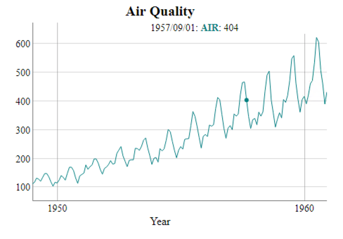
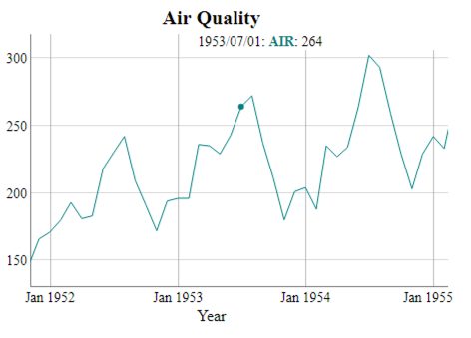
HTML & Graph produced
http://dygraphs.com
<div id="graph"></div>
Zoom
http://localhost:8888/example8.html

Slide 35
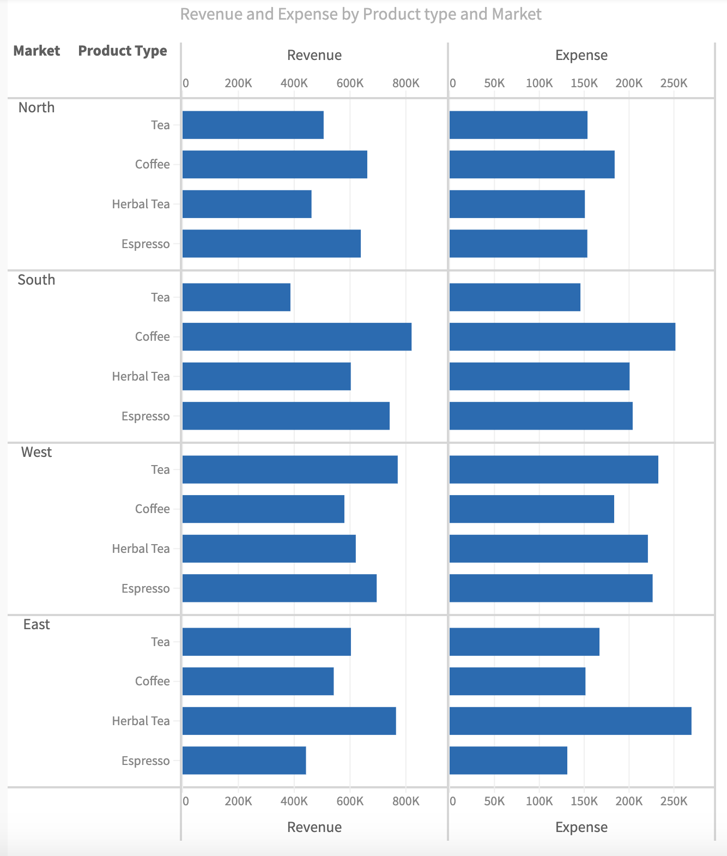
Muze
https://muzejs.org/examples
Supports multiple data formats
Auto connections and cross filtering
CSS Theming
Stacking Layout
Dynamic binding of reactions
Pseudo Immutability
https://muzejs.org/examples

Slide 36
HTML
https://muzejs.org/examples
Point to libraries
<link href="https://cdn.charts.com/lib/muze/core/latest/themes/muze.css" rel="stylesheet">
<script type="text/javascript" src="https://cdn.charts.com/lib/muze/core/latest/muze.js"></script>
<script type="text/javascript" src="js/jquery-3.2.1.min.js"></script>
Provide a div to put chart in
<div id="chart-container">
</div>
Notes:
Jquery + muze CSS and JavaScript

Slide 37
JavaScript
https://muzejs.org/examples
$(document).ready(function () {
$.ajax({
url: 'http://d351tq92/SASStoredProcess/do?_program=%2FUser+Folders%2Fphil%2FMy+Folder%2Fexample7',
success: function (data) {
const schema = [
{name: "Date", type: "dimension"},
{name: "Advertised", type: "dimension"},
{name: "Holiday", type: "dimension"},
{name: "Product", type: "dimension"},
{name: "Price", type: "measure"},
{name: "QtySold", type: "measure"}
];
const DataModel = muze.DataModel;
const dm = new DataModel (data['sashelp.snacks'], schema);
const env = muze();
const canvas = env.canvas();
canvas
.data(dm)
.width(1200)
.height(800)
.rows(["Product"])
.columns(["Price", "QtySold"], [])
.color("Holiday")
.legend({align: "horizontal",
steps: 6 })
.mount("#chart-container");
} }); // ajax
}) // end ready
Notes:
This is a bit different to other libraries
Define Schema, data model and canvas

Slide 38
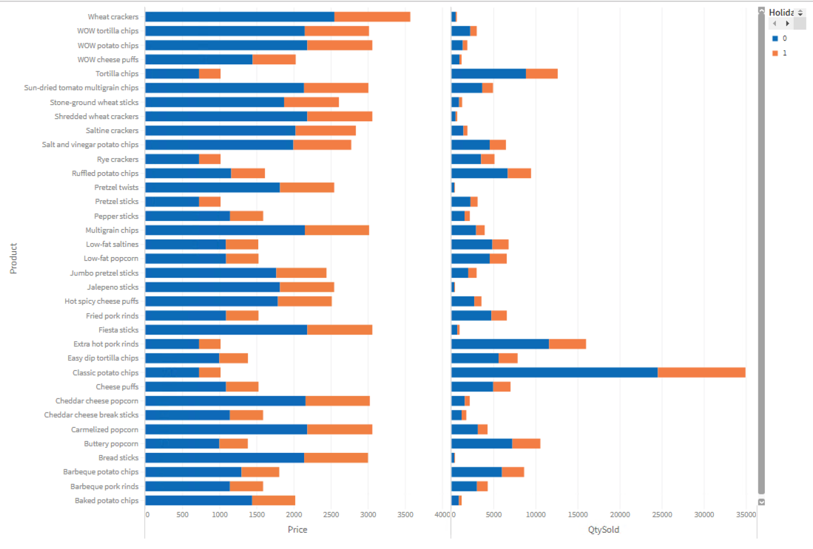
Previous code produces this
https://muzejs.org/examples
http://localhost:8888/example9.html

Slide 39
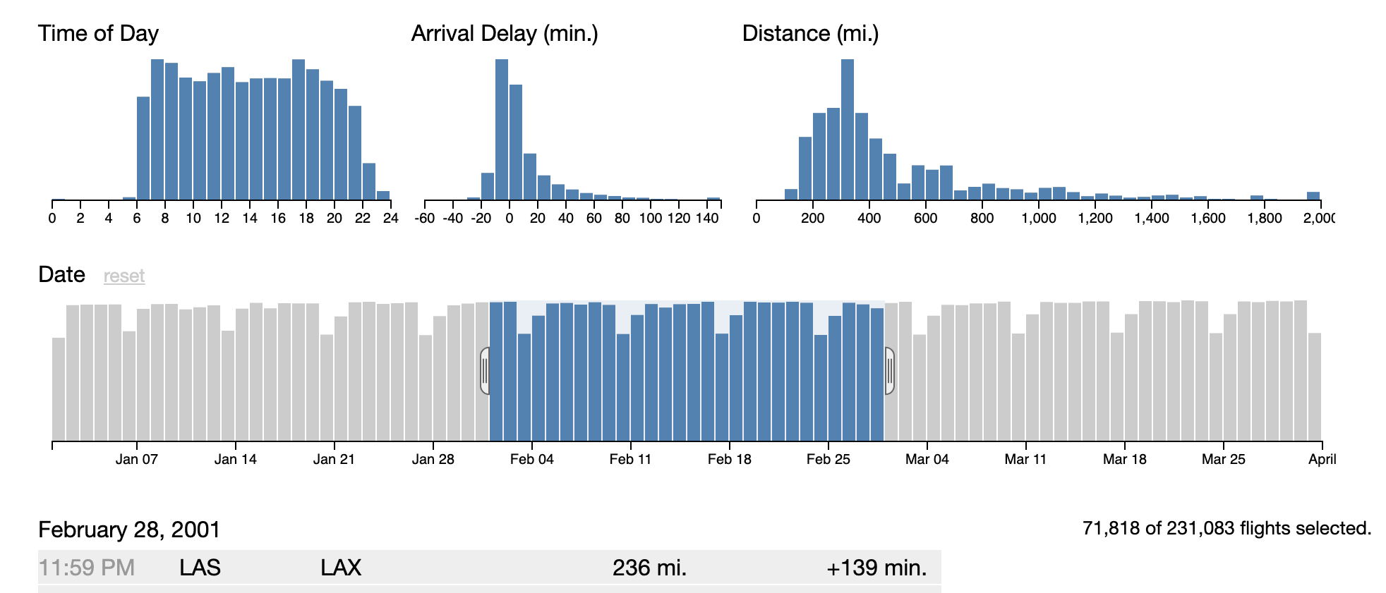
Cross Filters
https://dc-js.github.io/dc.js/
Explore large multivariate datasets in browser
Selecting something in one graph affects view of other graphs/tables
http://square.github.io/crossfilter/
Notes:
Click on link to show demo

Slide 40
HTML for CrossFilter
https://dc-js.github.io/dc.js/
<head>
<meta charset="UTF-8">
<link href="https://cdnjs.cloudflare.com/ajax/libs/dc/3.0.12/dc.css" rel="stylesheet">
<script type="text/javascript" src="https://cdnjs.cloudflare.com/ajax/libs/jquery/3.2.1/jquery.js"></script>
<script type="text/javascript" src="https://cdnjs.cloudflare.com/ajax/libs/d3/5.7.0/d3.js"></script>
<script type="text/javascript" src="https://cdnjs.cloudflare.com/ajax/libs/crossfilter/1.1.0/crossfilter.js"></script>
<script type="text/javascript" src="https://cdnjs.cloudflare.com/ajax/libs/dc/3.0.12/dc.js"></script>
</head>
<body>
<div class="container">
<div class="row">
<div class="col">
<div id="chart-ring-year" style="width:300px; height:300px"></div>
</div>
<div class="col">
<div id="chart-hist-spend" style="width:300px; height:300px"></div>
</div>
<div class="col">
<div id="chart-row-spenders"></div>
</div>
</div>
</div>
</body>
Notes:
More libraries needed for this
HTML fairly simple

Slide 41
JavaScript
https://dc-js.github.io/dc.js/
var yearRingChart = dc.pieChart("#chart-ring-year"),
spendHistChart = dc.barChart("#chart-hist-spend"),
spenderRowChart = dc.rowChart("#chart-row-spenders");
var spendData = [
{Name: "Greg", Spent: "$40", Year: 2017},
{Name: "Shaun", Spent: "$10", Year: 2017},
{Name: "Pascal", Spent: "$40", Year: 2017},
{Name: "Greg", Spent: "$70", Year: 2018},
{Name: "Shaun", Spent: "$20", Year: 2018},
{Name: "Shaun", Spent: "$50", Year: 2019},
{Name: "Pascal", Spent: "$30", Year: 2019} ];
spendData.forEach(function(d) {
d.Spent = d.Spent.match(/\d+/);
});
var ndx = crossfilter(spendData),
yearDim = ndx.dimension(function(d)
{return +d.Year;}),
spendDim = ndx.dimension(function(d)
{return Math.floor(d.Spent/10);}),
nameDim = ndx.dimension(function(d)
{return d.Name;}),
spendPerYear = yearDim.group().reduceSum(function(d)
{return +d.Spent;}),
spendPerName = nameDim.group().reduceSum(function(d)
{return +d.Spent;}),
spendHist = spendDim.group().reduceCount();
Notes:
For simplicity I haven’t used AJAX to get data – it’s in with code

Slide 42
JavaScript
https://dc-js.github.io/dc.js/
yearRingChart
.dimension(yearDim)
.group(spendPerYear)
.innerRadius(50)
.controlsUseVisibility(true);
spendHistChart
.dimension(spendDim)
.group(spendHist)
.x(d3.scaleLinear().domain([0,10]))
.elasticY(true)
.controlsUseVisibility(true);
spendHistChart.xAxis().tickFormat(function(d) {return d*10}); // convert back to base unit
spendHistChart.yAxis().ticks(2);
spenderRowChart
.dimension(nameDim)
.group(spendPerName)
.elasticX(true)
.controlsUseVisibility(true);
dc.renderAll();

Slide 43
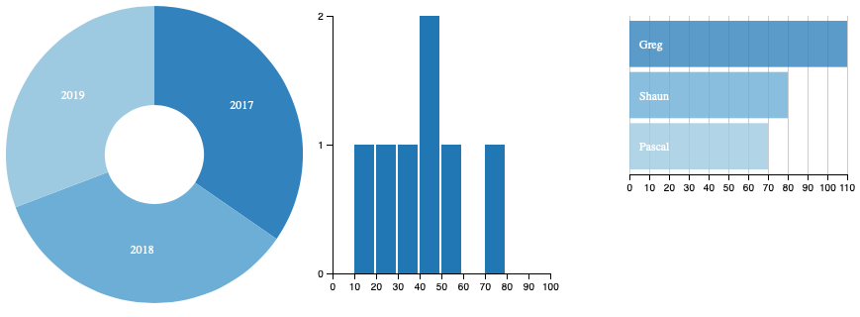
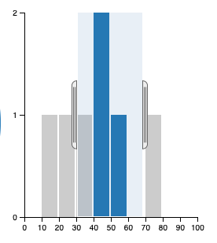
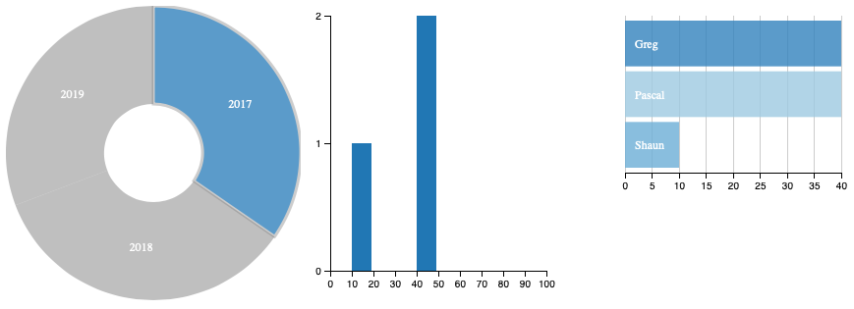
Clicking on a segment applies filter
Drag selector over bar chart applies filter for bars selected
http://localhost:8888/example11.html

Slide 44
HTML Data Adapter for SAS (H54S)
From Boemska
H54S is a library that facilitates and manages seamless bi-directional communication between a HTML5 (JavaScript) based Web Application and back-end data services written in SAS and deployed on the SAS Enterprise BI platform. It lets Web Programmers and SAS Developers collaborate easily to build general purpose Web Applications with unprecedented speed and agility.
https://boemskats.com/h54s/
https://github.com/Boemska/h54s

Slide 45
Building Web Applications
Use a CSS Framework like Bootstrap 4
Consider more advanced frameworks like React
Consider using GitHub
Buy my book from SAS Publishing

Slide 46
References
jQuery … https://jquery.com/
dataTables … https://datatables.net
Pivot tables … https://pivottable.js.org/examples/
Dygraphs … http://dygraphs.com
h54s … https://boemskats.com/h54s/ & https://github.com/Boemska/h54s
muze ... https://github.com/chartshq/muze & https://www.charts.com/muze
DC … https://dc-js.github.io/dc.js/
Crossfilters … http://dc-js.github.io/dc.js/ & http://square.github.io/crossfilter/

Slide 47
Thank you!
Contact Information phil@woodstreet.org.uk
Reminder: Complete your session survey in the conference mobile app.

